Slide 1

Robust Multi-Agent Reinforcement Learning for Self-Adaptive Systems
Christian Adriano (Chris)
Prof. Dr. Holger Giese
System Analysis and Modeling Group
Our contact: first-name.last-name@hpi.de
Notes:
Hi, I am Chris, I will present our master project on Robust Multi-Agent Reinforcement Learning for Self-Adaptive Systems

Slide 2
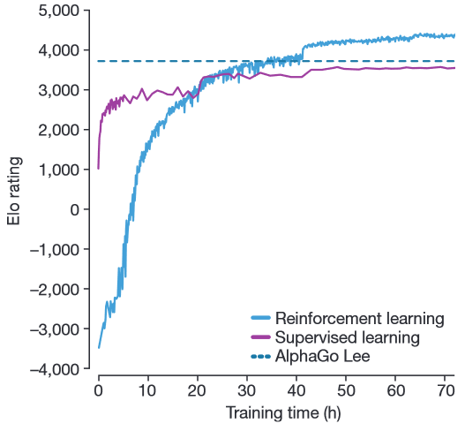
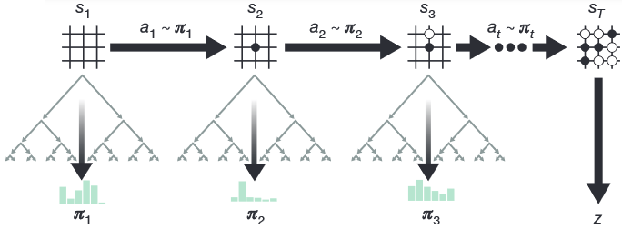
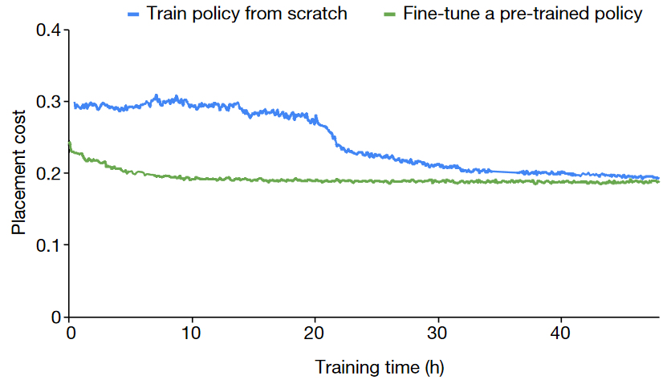
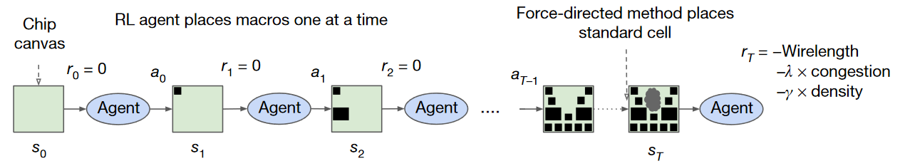
Context – The Progress of Reinforcement Learning
Alpha Go-Zero learned to win without supervision, only by self-play [DeepMind 2017]
RL agent designed optimal layouts for TPU chip circuit [Google 2021]
Notes:
- Let's start with some context on the progress of reinforcement learning. Alpha Go-Zero learned to win the famous game of Go without supervision. Instead, it learned by playing against previous versions of itself. Besides that, as the blue and purple curves here show, the self-play approach achieved higher performance than the previous version of the Alpha-Go. If you recall, the one that defeated the world-champion.
-Another recent progress. This year Google announced that a reinforcement learning agent was able to design optimal circuit layouts for its TensorFlow chip. A feat that was still beyond the capacity of automated tools.

Slide 3
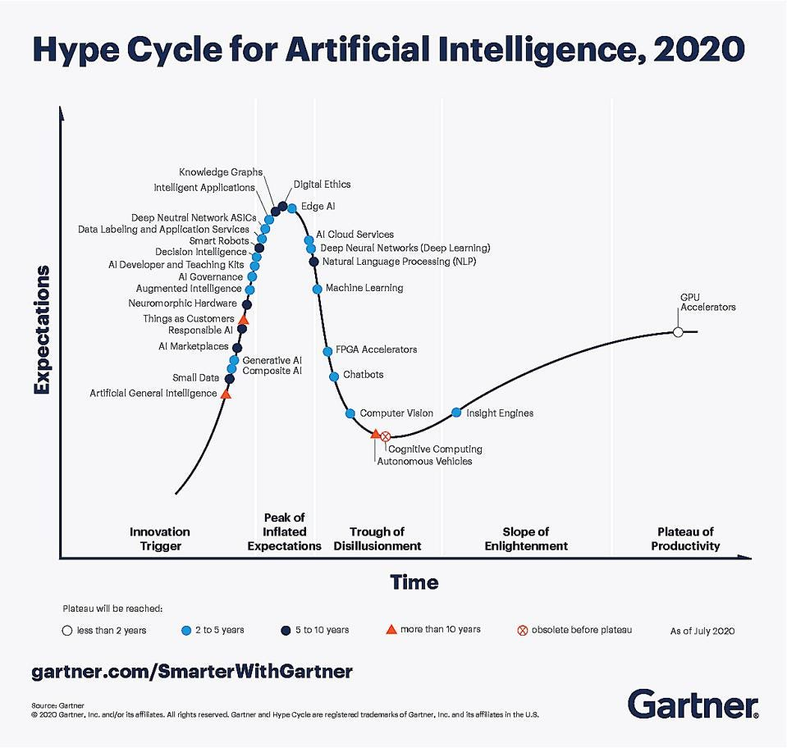
However AI systems are not being deployed
55% of companies surveyed haven't deployed a machine learning model [Algorithmia 2020]
72% that began AI pilots before 2019 haven’t deployed a single system yet [Capgemini 2020]
Why? Current models cannot adapt to more complex and evolving realities - adversarial environment
[Gartner 2020]
Problem? Lack of Robustness in AI Systems
[Jordan 2019], [D’Amour et al. 2020]
Notes:
-However, industry surveys report that from 55 to 72% of companies are not being able to deploy AI systems.
-Why? Because the current systems cannot adapt to more complex and evolving realities. Realities that play like strong adversaries against these AI systems.
-The inability to adapt is a problem of lack of robustness in these AI Systems.

Slide 4
Nature of the Problem - Structure vs Frequency
Degree of structure
Physical laws
traffic
protein folding
circuit design
2
Artificial laws
games
simulators
software systems
1
Strong
(well-constrained)
[Google 2021]
[DeepMind 2017]
3
Human laws
human-in-the loop
image & text interfaces
Adversarial laws
malicious attacks
chaotic systems
4
Medium
(under-specified)
[!]
[Gao et al. 2021]
Sparse
(causal associations)
Dense
(accidental associations)
Frequency of events
Notes:
- Before we search for solutions, let’s try to understand the nature of this problem. It has two dimensions:
how structured the laws are, for instance, well-constrained as in quadrants 1 and 2 corresponding to the artificial laws in games or the physical laws in circuit design and how frequent the events are, like high frequency as in quadrants 1 and 4 or sparse as in 2 and 3.
- Many solutions cover quadrants 1, 2, and 4, but quadrant 3 of adversarial laws is under-explored, as it is more challenging.
In the last 2 years, our group has been exploring exactly this quadrant 3.

Slide 5

Architecture, Case Study and Project Goals
Architecture
State and Reward
Project Goals & Techniques
1.Reward sparsity
(large state space)
Environment
Agent
Integration Layer
Hallucinates Environment
off-fine & online RL
robust MDPs
2. Distribution shift
(unsafe actions)
Action
malicious
multi-agents
Case Study
Platform: E-Commerce for online shops
States: Component failure modes
Actions:
Self-Repair
Self-Optimization
3. Concept drift
(accidental associations)
Incremental
causal discovery
reward shaping
[Vogel et al. 2018]
4. Domain shift
(unsafe states)
Technology stack:
PyTorch/Tensor Flow, Open AI Gym, GraphQL, etc.
domain adaptation
meta-learning
Notes:
-For that we are extending the standard reinforcement learning architecture. We have an integration layer so the environment can expose states and rewards, while in the agent side we have a simulator for the agent to hallucinate (predict) the behavior of the environment, which has shown to be more effective for planning actions, particularly when not all states are visible.
-As a case study, we adopted an e-commerce platform for online shops, whose states represent component failure modes, and the actions allow to repair or optimize the failing components
-This is our technology stack, but we are open to other tools as well.
-Finally, we have a set of clear goals for the project that we will tackle very incrementally. First will be the reward sparsity that is caused by large state spaces, then Distribution shift, Concept drift, and Domain shift with their corresponding causes. For each of these subgoals we will apply the state-of-art techniques as exemplified here. Thank you for you attention. We will be happy to answer questions by email or video-conference.

